Slide 1
Diet & Wellness +
McMaster University
LIFESCI 2N03
Shelley Vanderhout

Slide 2
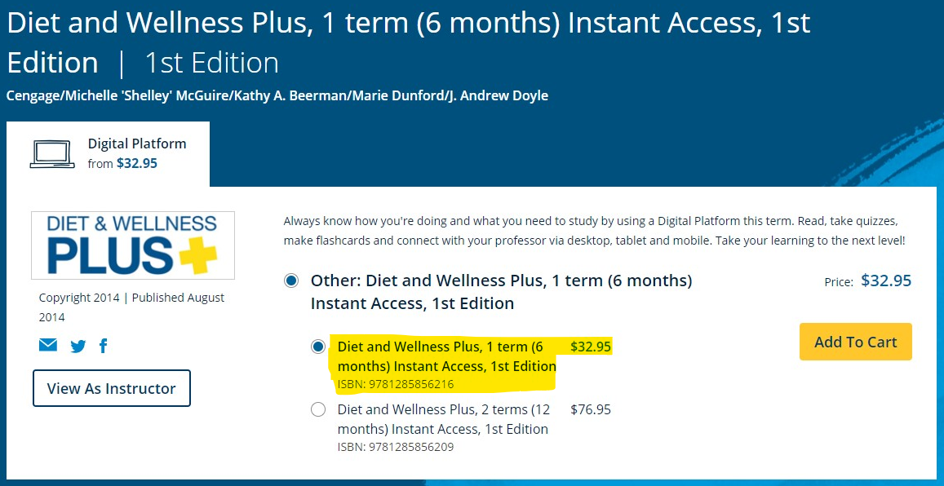
Locate Your Course Materials
Visit Cengage.ca and search by ISBN (9781285856216 for 6-month access)
In the search results select: Diet and Wellness Plus, 1st Edition.
Follow the on-screen instructions to purchase standalone access to Diet and Wellness Plus.
If you’ve used/purchased a Cengage product before (MindTap, WebAssign, SAM), you have an account. Login.
If you are new to Cengage, create an account. We highly suggest you use your school email address.
Get an additional 10% off with this code: DIGITALB2S1479

Slide 3
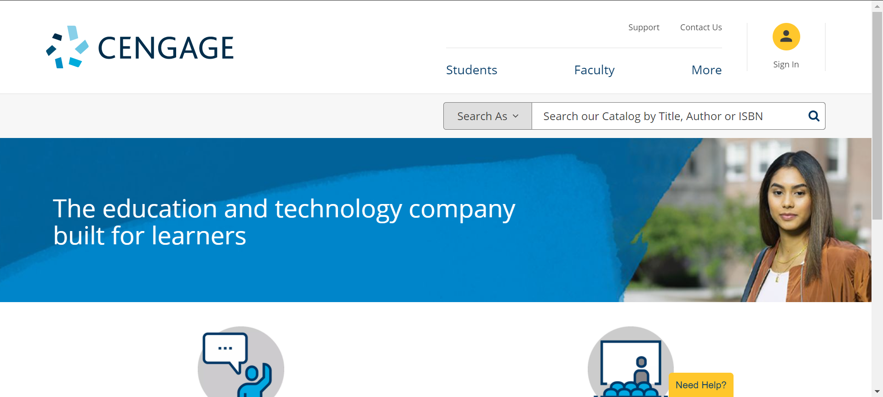
Access to Diet & Wellness Plus
Go to cengage.ca/dashboard/#/login and sign into your account.
If you purchased from Cengage.ca, make sure to login with the same email address you used to purchase.
Once logged in, you’ll see your dashboard.
If you purchased Diet & Wellness Plus instant access, it will appear on your dashboard.
If you purchased a Printed Access Card, click “Add a course or register a product” and enter the access code from the card.

Slide 4
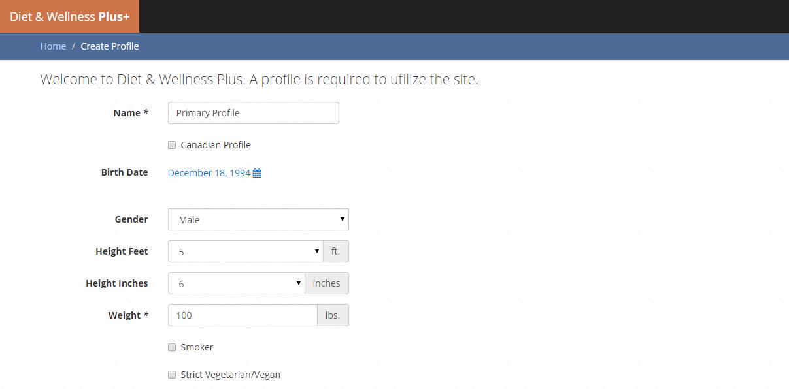
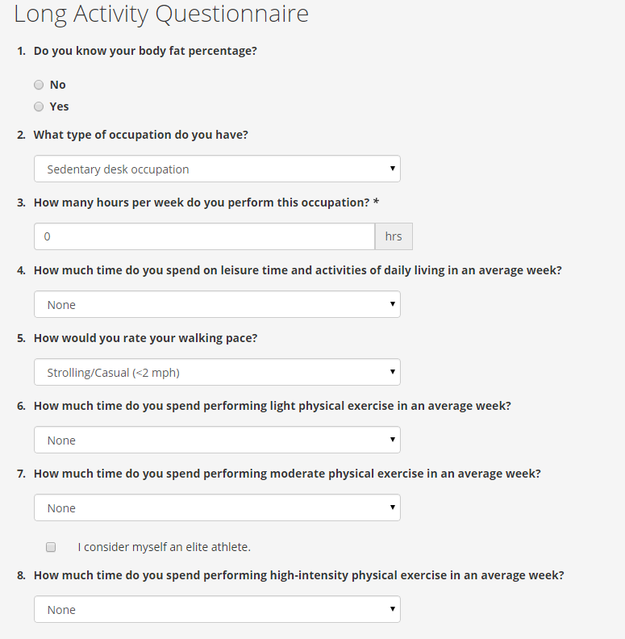
Setting Up Your Profile
On your first visit:
Create your primary profile.
Complete the activity questionnaire.
1
2

Slide 5
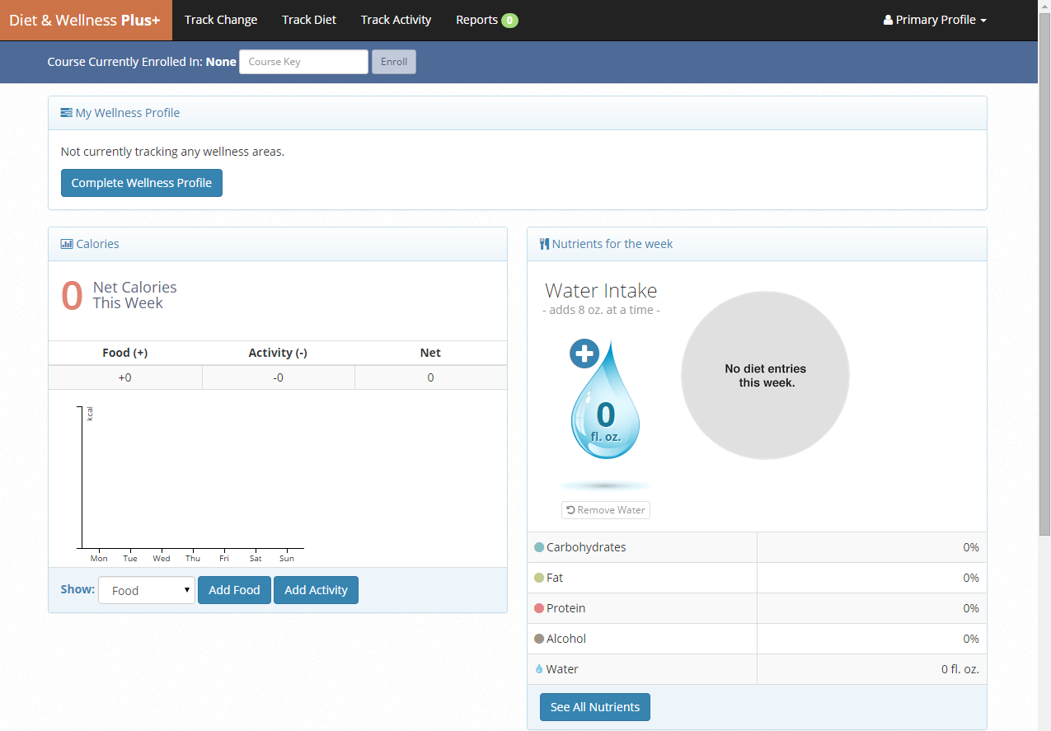
Your Homepage
Track diet and activity.
Generate personalized reports.
A
B

Slide 6
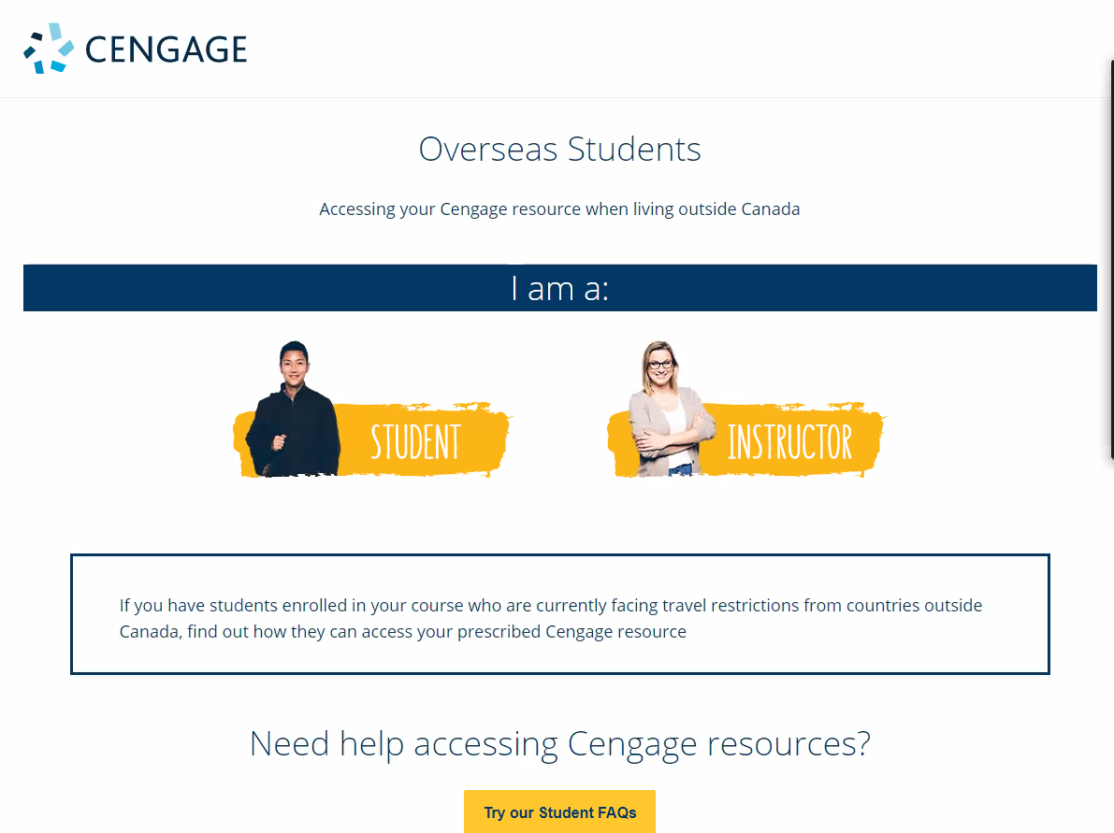
Outside Canada?
Go to this link:
info.cengage.com/international
Click Student
Click the option for your location to learn how to purchase your Cengage Canada materials
International Students

Slide 7

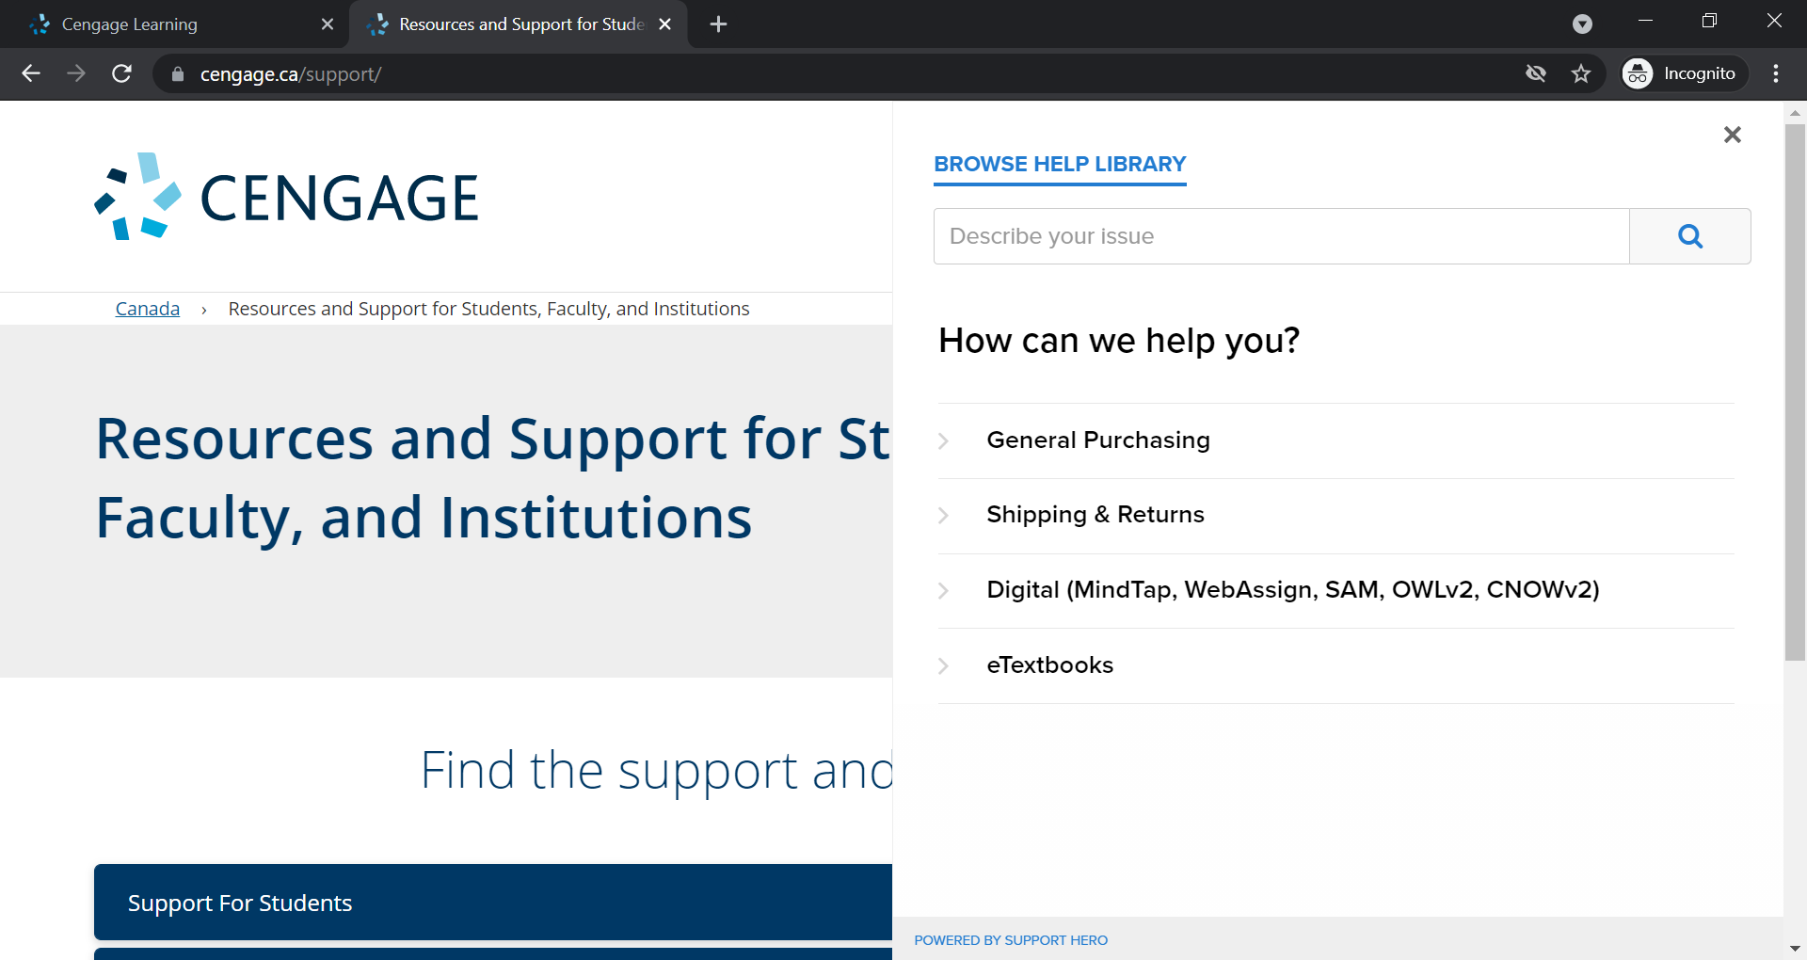

Have Questions? We’re Here to Help!
Visit our student support site at
Cengage.ca/student-support
Still Need Help?
Contact Customer Support at https://support.cengage.ca/

